Slide 1
ABM Facility Data Ingestion Architecture
Transforming Operations Through Data Integration
Revised Architecture for
Enhanced Reliability, Scalability & Security
Presented by: Horea Lazar
Date: July 18, 2025

Slide 2
The Challenge
Before: Manual Operations
Manual job scheduling and inventory tracking
Duplicate tasks and stock issues
Data stuck in separate systems
No real-time visibility into operations
The Solution
A scalable data ingestion pipeline that integrates all data sources, enabling:
Real-time analytics and decision-making
Optimised scheduling and inventory management
Proactive maintenance and quality control

Slide 3
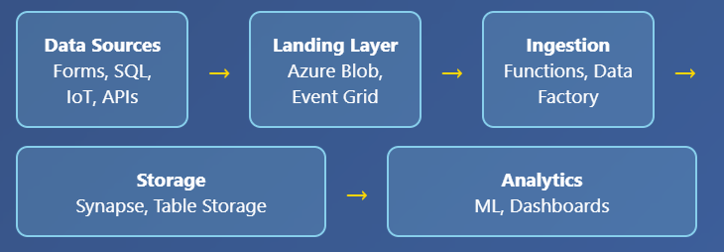
Revised Architecture
Key Enhancements
Event-driven processing with Azure Event Grid
Advanced data validation and quality checks
Real-time streaming capabilities
Enhanced security and compliance measures

Slide 4
Data Quality & Validation
5-Step Validation Process
Schema Validation: Predefined schemas ensure data structure integrity
Data Type Checking: Validates field types and acceptable ranges
Deduplication: Automatic detection and removal of duplicate entries
Cross-Reference: Verification against master data tables
Error Handling: Automated logging and alerts for validation failures
Result: Only high-quality, trustworthy data flows through the pipeline for analytics and decision-making

Slide 5
Security & GDPR Compliance
Security Measures
Azure Active Directory with MFA
AES-256 encryption at rest
TLS 1.2+ for data in transit
Private endpoints and network security
Real-time threat monitoring
GDPR Compliance
Automated PII discovery and masking
Data minimisation principles
Efficient DSAR fulfilment
Regular privacy impact assessments
Automated breach response

Slide 6
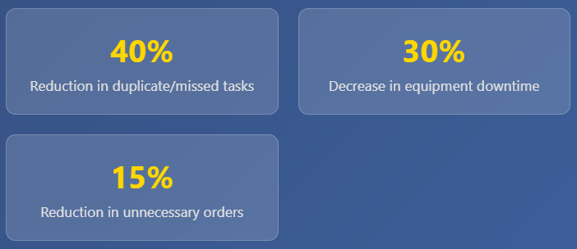
Results & Business Impact
Key Success Stories
Predictive Maintenance: IoT sensors now trigger automatic maintenance alerts, preventing costly failures
Inventory Optimisation: Real-time tracking prevents over/under-ordering
Operational Efficiency: Supervisors freed up for strategic tasks vs. manual reconciliation

Slide 7
Future Roadmap
Next Phase Improvements
Enhanced AI Integration: Automated anomaly detection within Azure Functions
Expanded IoT: More sensors for comprehensive predictive maintenance
Advanced Streaming: Apache Kafka or Azure Event Hubs for high-volume data
Self-Service Compliance: Automated GDPR dashboards for transparency
Scalability: Kubernetes implementation for better resource management

